Slide 1
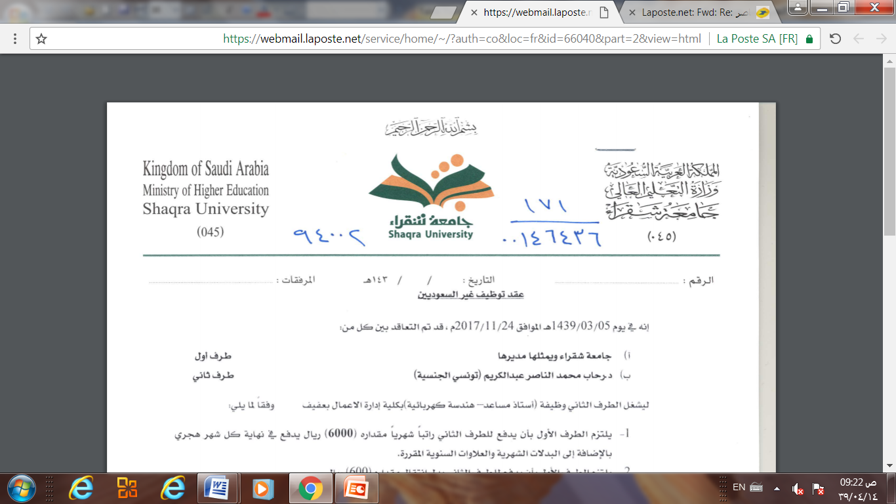
Database Management system
Chapter 3
The Relational Data Model
&
Relational Database constraints
Dr. Rihab Mohamed Naceur ABDELKRIM
E-mail: rihab@su.edu.sa
2017 - 2018

Slide 2
Chapter Outline
1- Relational Model Concepts
2- Relational Model Constraints and Relational Database Schemas
3- Update Operations, Transactions and Dealing with Constraint Violations
4-codd’s rule for relational database

Slide 3
1- Relational Model Concepts
1-1- Definition
The relational Model of Data is based on the concept of a Relation.
The strength of the relational approach to data management comes from the formal foundation provided by the theory of relations.
We review the essentials of the formal relational model in this chapter.
In practice, there is a standard model based on SQL – this is described in following Chapters as a language.

Slide 4
1- Relational Model Concepts
1-1- Definition
A Relation is a mathematical concept based on the ideas of sets.
The model was first proposed by Dr. E.F. Codd of IBM Research in 1970 in the following paper:
"A Relational Model for Large Shared Data Banks," Communications of the ACM, June 1970
The above paper caused a major revolution in the field of database management and earned Dr. Codd the coveted ACM Turing Award.

Slide 5
1- Relational Model Concepts
1-2-Domains, attribute, Tuples and relations
-Domain D
Set of atomic values
- Atomic
Each value indivisible
Specifying a domain
Data type specified for each domain

Slide 6
1- Relational Model Concepts
1-2-Domains, attribute, Tuples and relations
A domain has a logical definition:
Example: “USA_phone_numbers” are the set of 10 digit phone numbers valid in the U.S.
A domain also has a data-type or a format defined for it.
The USA_phone_numbers may have a format: (ddd)ddd-dddd where each d is a decimal digit.
Dates have various formats such as year, month, date formatted as yyyy-mm-dd, or as dd mm,yyyy etc.
The attribute name designates the role played by a domain in a relation:
Used to interpret the meaning of the data elements corresponding to that attribute
Example: The domain Date may be used to define two attributes named “Invoice-date” and “Payment-date” with different meanings

Slide 7
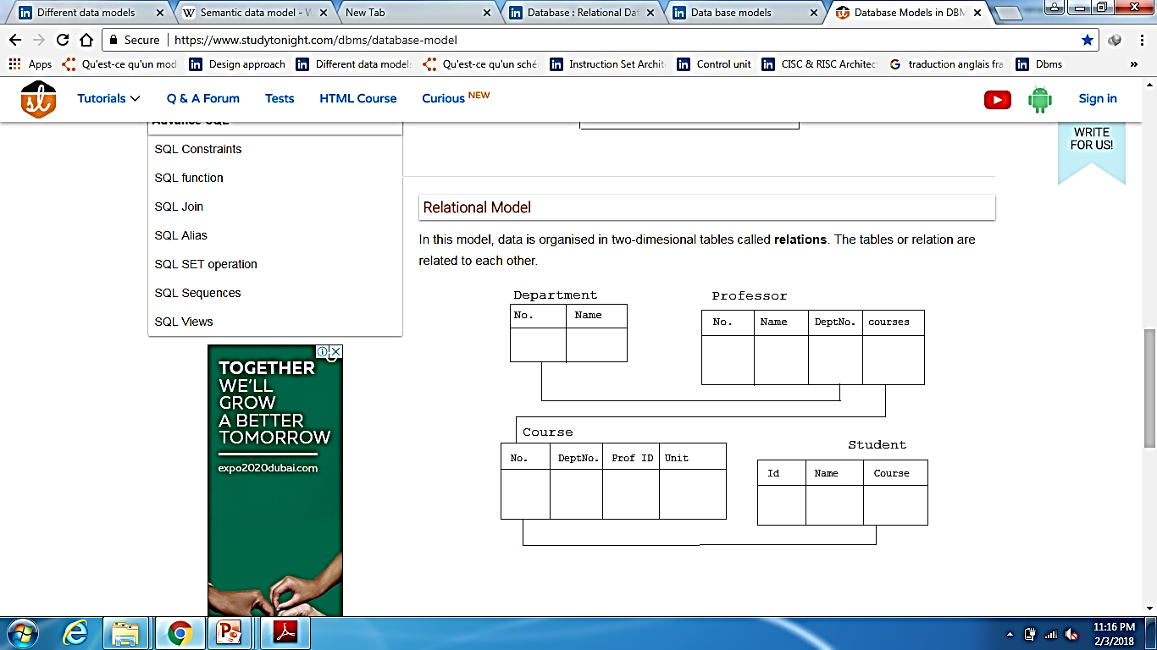
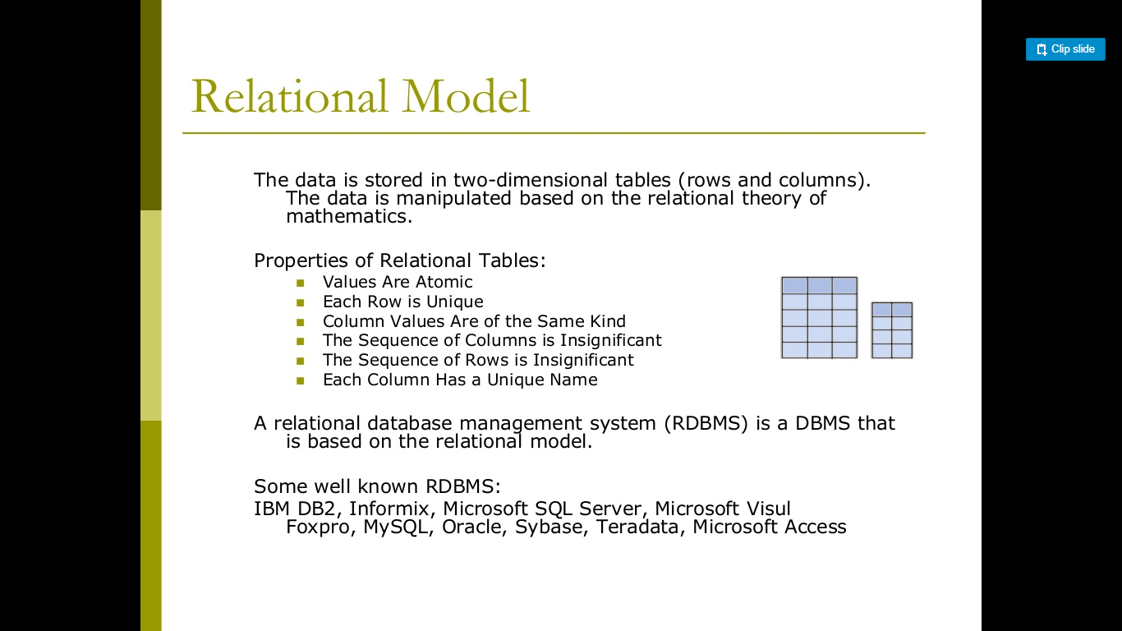
Informal Definitions
1- Relational Model Concepts
1-2-Domains, attribute, Tuples and relations
Informally, a relation looks like a table of values.
A relation typically contains a set of rows.

Slide 8
1- Relational Model Concepts
1-2-Domains, attribute, Tuples and relations
The data elements in each row represent certain facts that correspond to a real-world entity or relationship.
In the formal model, rows are called tuples.
Each column has a column header that gives an indication of the meaning of the data items in that column.
In the formal model, the column header is called an attribute name (or just attribute)

Slide 9
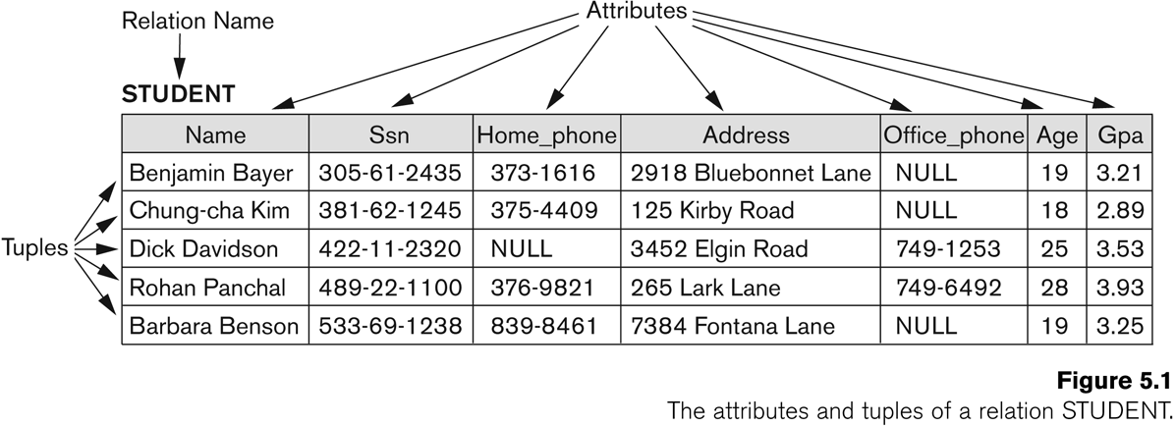
1- Relational Model Concepts
1-2-Domains, attribute, Tuples and relations
Example
Figure 3.1

Slide 10
1- Relational Model Concepts
1-2-Domains, attribute, Tuples and relations
Key of a Relation:
Each row has a value of a data item (or set of items) that uniquely identifies that row in the table
Called the key.
In the STUDENT table, SSN is the key
Sometimes row-ids or sequential numbers are assigned as keys to identify the rows in a table
Called artificial key or surrogate key.

Slide 11
1- Relational Model Concepts
1-2-Domains, attribute, Tuples and relations
The Schema (or description) of a Relation:
Denoted by R(A1, A2, .....An)
R is the name of the relation
The attributes of the relation are A1, A2, ..., An
Example:
CUSTOMER (Cust-id, Cust-name, Address, Phone#)
CUSTOMER is the relation name
Defined over the four attributes: Cust-id, Cust-name, Address, Phone#
Each attribute has a domain or a set of valid values.
For example, the domain of Cust-id is 6 digit numbers.

Slide 12
1- Relational Model Concepts
1-2-Domains, attribute, Tuples and relations
A tuple is an ordered set of values (enclosed in angled brackets ‘< … >’)
Each value is derived from an appropriate domain.
A row in the CUSTOMER relation is a 4-tuple and would consist of four values, for example:
<632895, "John Smith", "101 Main St. Atlanta, GA 30332", "(404) 894-2000">
This is called a 4-tuple as it has 4 values
A tuple (row) in the CUSTOMER relation.
A relation is a set of such tuples (rows)

Slide 13
1- Relational Model Concepts
1-2-Domains, attribute, Tuples and relations
The relation state is a subset of the Cartesian product of the domains of its attributes
each domain contains the set of all possible values the attribute can take.
Example: attribute Cust-name is defined over the domain of character strings of maximum length 25
dom(Cust-name) is varchar(25)
The role these strings play in the CUSTOMER relation is that of the name of a customer.

Slide 14
1- Relational Model Concepts
1-2-Domains, attribute, Tuples and relations
Formally,
Given R(A1, A2, .........., An)
r(R) ⊂ dom (A1) X dom (A2) X ....X dom(An)
R(A1, A2, …, An) is the schema of the relation
R is the name of the relation
A1, A2, …, An are the attributes of the relation
r(R): a specific state (or "value" or “population”) of relation R – this is a set of tuples (rows)
r(R) = {t1, t2, …, tn} where each ti is an n-tuple
ti = <v1, v2, …, vn> where each vj element-of dom(Aj)

Slide 15
1- Relational Model Concepts
1-2-Domains, attribute, Tuples and relations
Example
Let R(A1, A2) be a relation schema:
Let dom(A1) = {0,1}
Let dom(A2) = {a,b,c}
Then: dom(A1) X dom(A2) is all possible combinations:
{<0,a> , <0,b> , <0,c>, <1,a>, <1,b>, <1,c> }
included in
The relation state r(R) ⊂ dom(A1) X dom(A2)
For example: r(R) could be {<0,a> , <0,b> , <1,c> }
this is one possible state (or “population” or “extension”) r of the relation R, defined over A1 and A2.
It has three 2-tuples: <0,a> , <0,b> , <1,c>

Slide 16
1- Relational Model Concepts
1-2-Domains, attribute, Tuples and relations
Informal Terms |  | Formal Terms
Table |  | Relation
Column Header |  | Attribute
All possible Column Values |  | Domain
Row |  | Tuple
Table Definition |  | Schema of a Relation
Populated Table |  | State of the Relation

Slide 17
1- Relational Model Concepts
1-2-Domains, attribute, Tuples and relations
Example
Figure 3.1

Slide 18
1- Relational Model Concepts
1-3-Characteristics
Ordering of tuples in a relation r(R):
The tuples are not considered to be ordered, even though they appear to be in the tabular form.
Ordering of attributes in a relation schema R (and of values within each tuple):
We will consider the attributes in R(A1, A2, ..., An) and the values in t=<v1, v2, ..., vn> to be ordered .
(However, a more general alternative definition of relation does not require this ordering. It includes both the name and the value for each of the attributes ).
Example: t= { <name, “John” >, <SSN, 123456789> }
This representation may be called as “self-describing”.

Slide 19
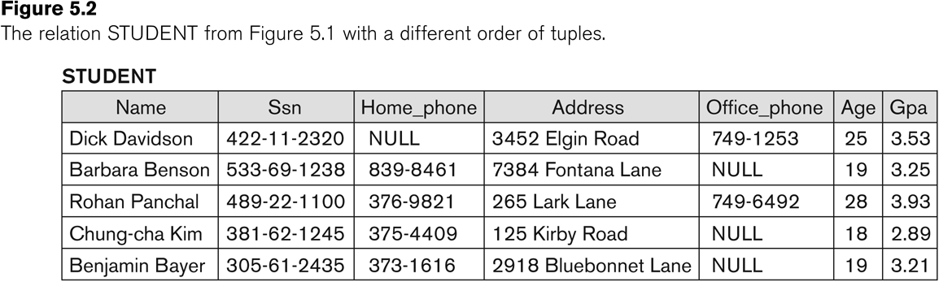
1- Relational Model Concepts
1-3-Characteristics
Figure 3.2
Figure 3.1

Slide 20
1- Relational Model Concepts
1-3-Characteristics
Values in a tuple:
All values are considered atomic (indivisible).
Each value in a tuple must be from the domain of the attribute for that column
If tuple t = <v1, v2, …, vn> is a tuple (row) in the relation state r of R(A1, A2, …, An)
Then each vi must be a value from dom(Ai).
A special null value is used to represent values that are unknown or not available or inapplicable in certain tuples.

Slide 21
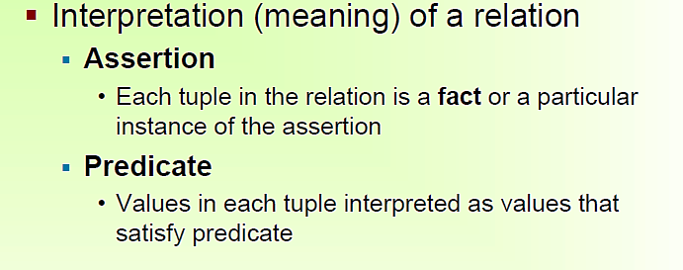
1- Relational Model Concepts
1-3-Characteristics
For example,
the first tuple in Figure 3.1 asserts the fact that there is a STUDENT whose Name is Benjamin Bayer, Ssn is 305-61-2435, Age is 19, and so on.
An alternative interpretation of a relation schema is as a predicate;
in this case, the values in each tuple are interpreted as values that satisfy
the predicate.
For example, the predicate STUDENT (Name, Ssn, ...) is true for the five tuples
in relation STUDENT of Figure 5.1.

Slide 22
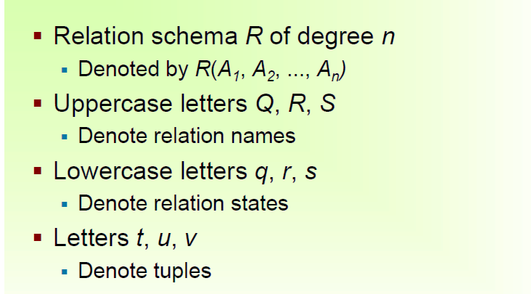
1- Relational Model Concepts
1-4-Notations

Slide 23
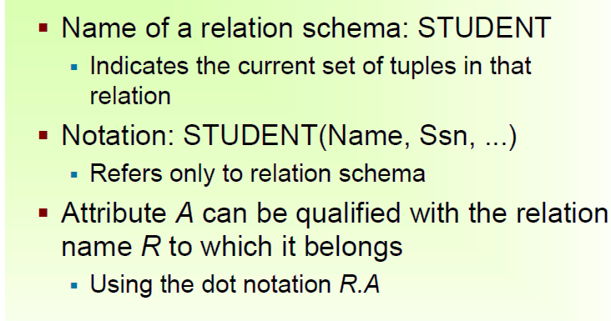
1- Relational Model Concepts
1-4-Notations

Slide 24
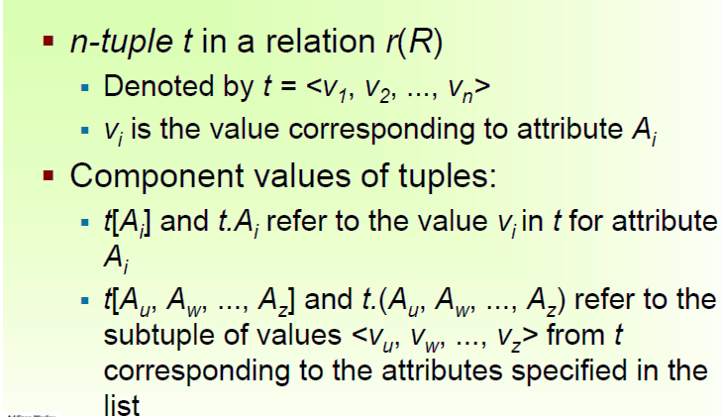
1- Relational Model Concepts
1-4-Notations

Slide 25
Do you have any questions ???
???

